Slide 1
Extensive and intensive state functions
If you know the value of an extensive state function, you could (in principle) back out how many molecules you have. Knowing the value of an intensive state function doesn’t help with that. Examples: n, P, T, V, M, m.
Which are extensive?
Which are intensive?

Slide 2
Extensive and intensive state functions
If you know the value of an extensive state function, you could (in principle) back out how many molecules you have. Knowing the value of an intensive state function doesn’t help with that. Examples: n, P, T, V, M, m.
Which are extensive? n, V (and U, which we’ll get to next)
Which are intensive? P, T, M, m

Slide 3
What internal energy (“U”) is
It’s all the molecular energy in a given sample. We divide it into these parts
The kinetic part is energy of motion: translational, rotational, and vibrational motions
The potential part is like the energy in a compressed spring – not moving, but energy that’s potentially available. At the molecular level, we talk about the potential energy of vibration, in that a molecule could be compressed or stretched out (much like a spring). Translational and rotational motions don’t have potential energy.

Slide 4
Degrees of freedom
What’s a degree of freedom? For starters, each direction in space is 1 degree of freedom.
This molecule has three degrees of translational freedom

Slide 5
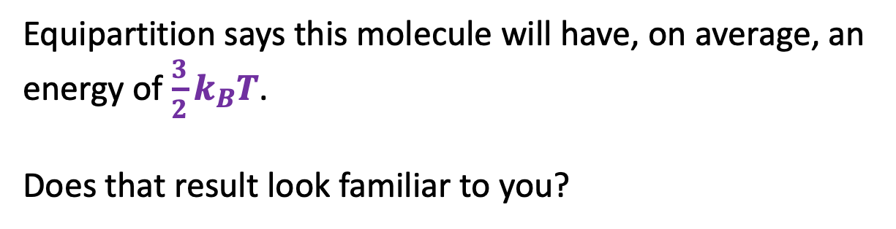
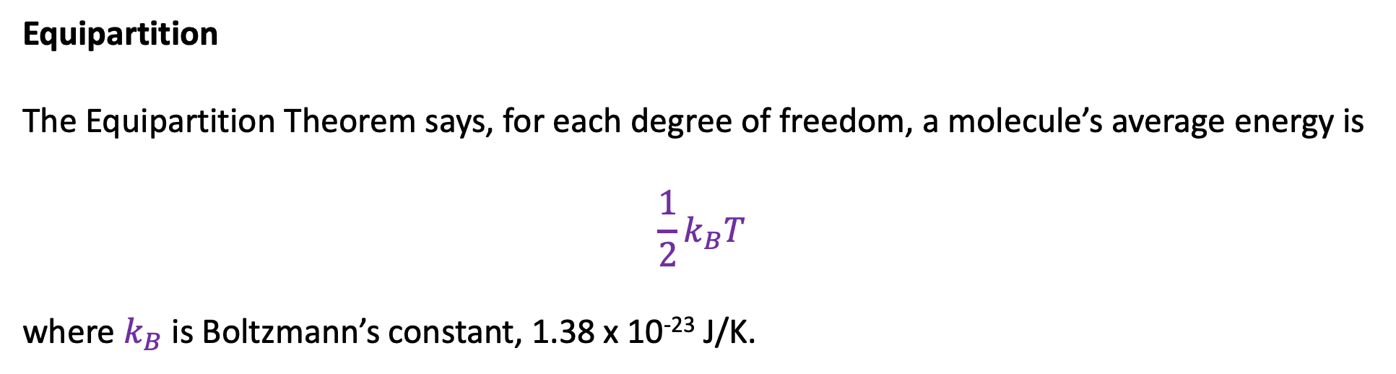
Equipartition
The Equipartition Theorem says, for each degree of freedom, a molecule’s average energy is
$$\frac{1}{2}k_{B}T$$
where $k_{B}$ is Boltzmann’s constant, 1.38 x 10⁻²³ J/K.
Equipartition says this molecule will have, on average, an energy of $\frac{3}{2}k_{B}T$.
Does that result look familiar to you?

Slide 6
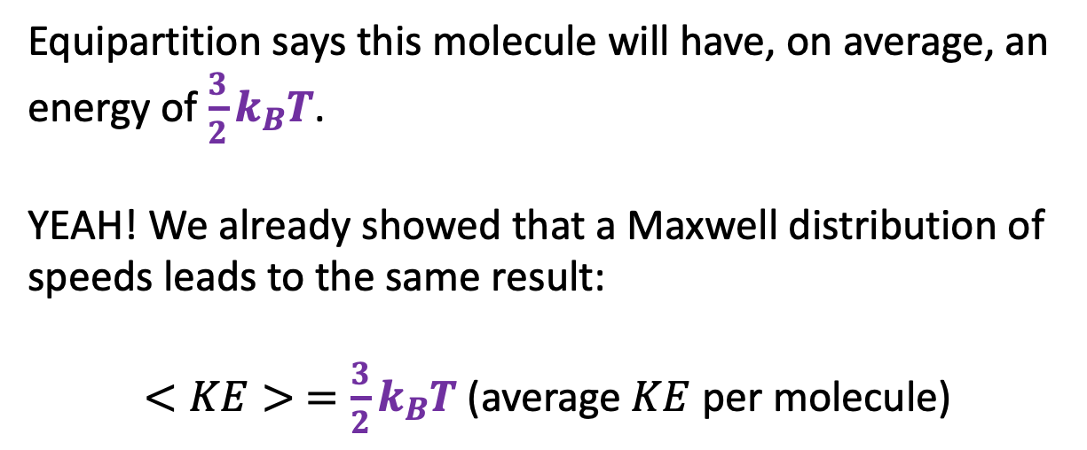

Equipartition
The Equipartition Theorem says, for each degree of freedom, a molecule’s average energy is
$$\frac{1}{2}k_{B}T$$
where $k_{B}$ is Boltzmann’s constant, 1.38 x 10⁻²³ J/K.
Equipartition says this molecule will have, on average, an energy of $\frac{3}{2}k_{B}T$.
YEAH! We already showed that a Maxwell distribution of speeds leads to the same result:
$<KE> =\frac{3}{2}k_{B}T$ (average $KE$ per molecule)

Slide 7
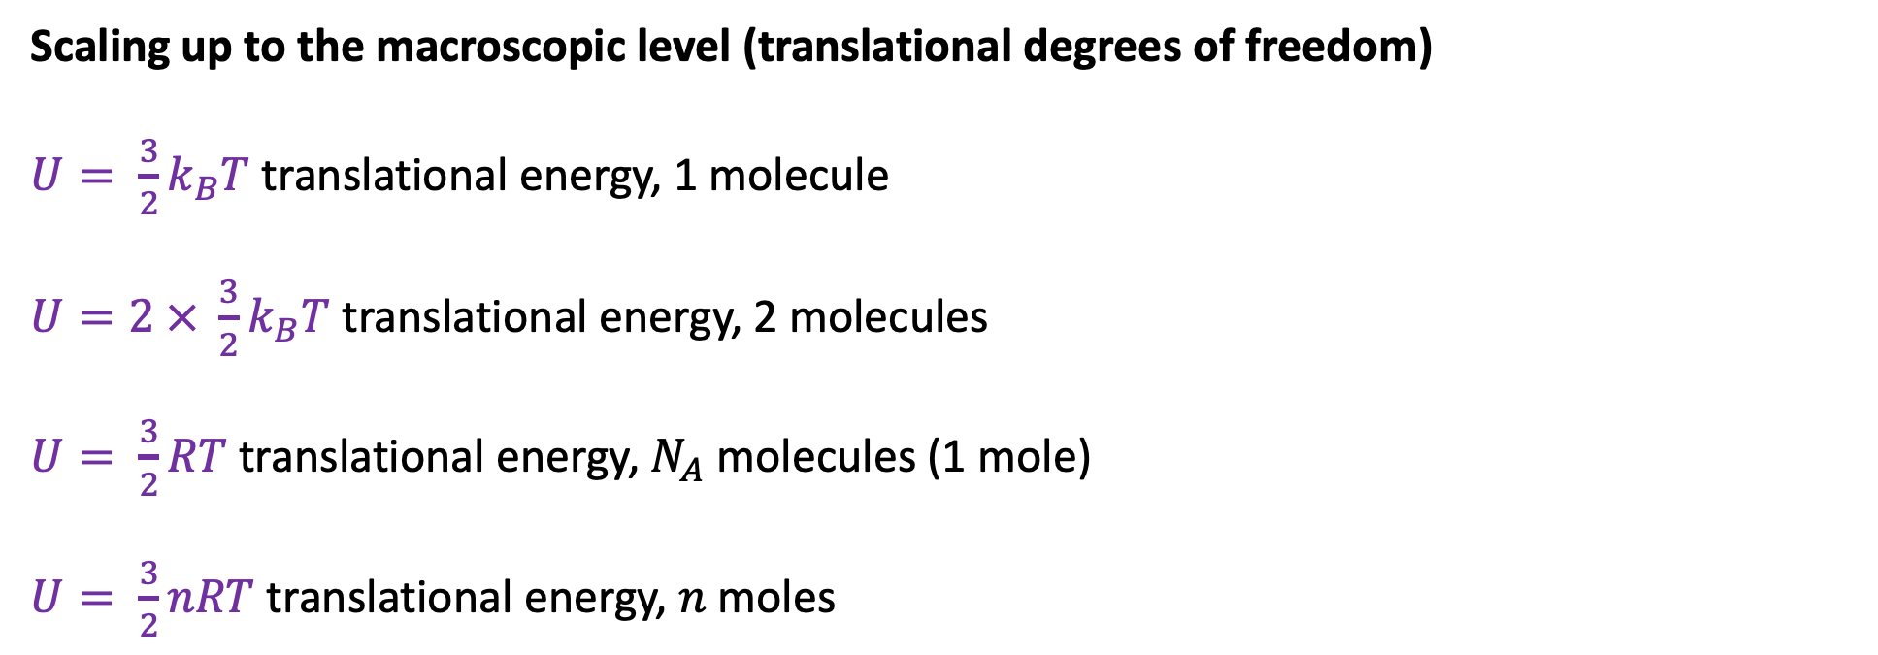
Scaling up to the macroscopic level (translational degrees of freedom)
$U= \frac{3}{2}k_{B}T$ translational energy, 1 molecule
$U=2 × \frac{3}{2}k_{B}T$ translational energy, 2 molecules
$U= \frac{3}{2}RT$ translational energy, $N_{A}$ molecules (1 mole)
$U= \frac{3}{2}nRT$ translational energy, $n$moles

Slide 8
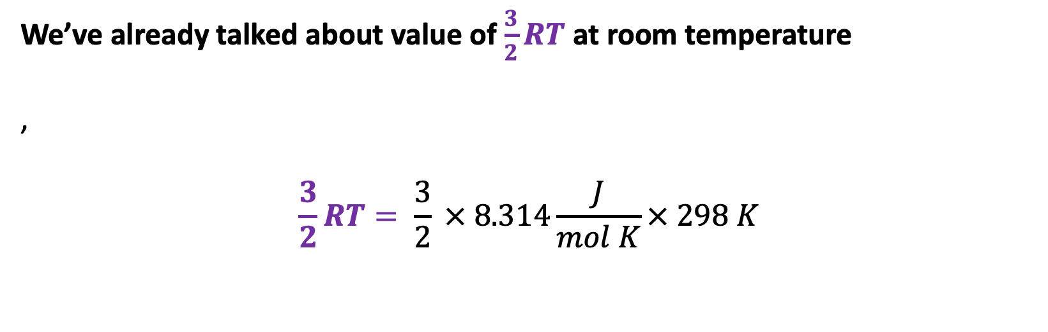
We’ve already talked about value of $\frac{3}{2}RT$ at room temperature
,
$$\frac{3}{2}RT= \frac{3}{2} × 8.314\frac{J}{mol K}× 298 K$$

Slide 9
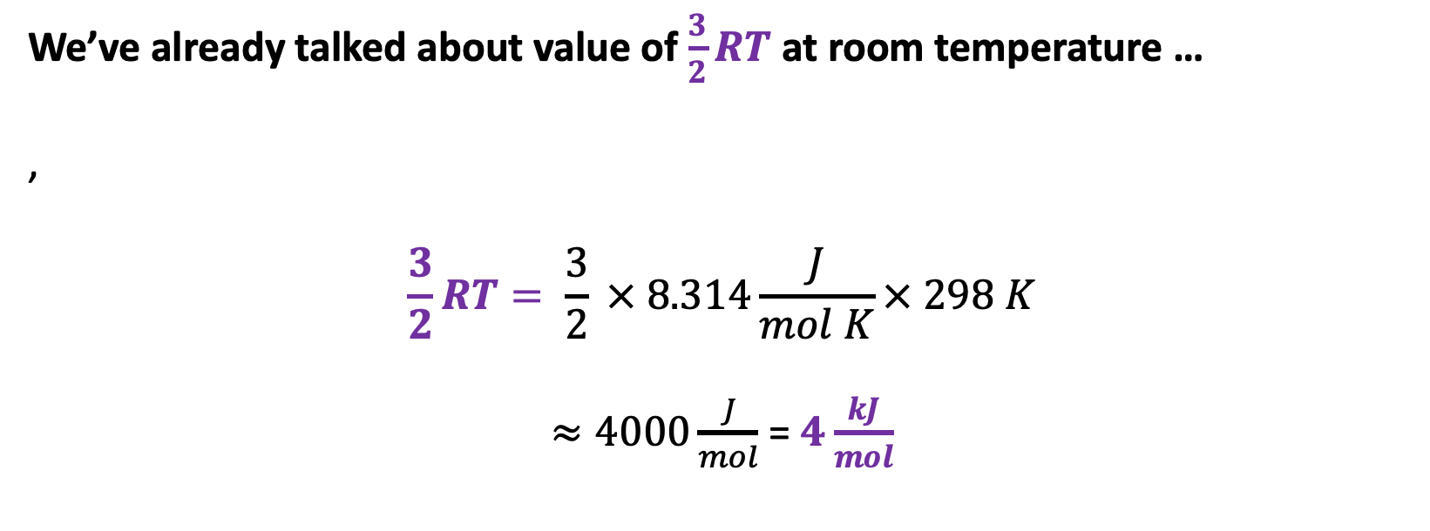
We’ve already talked about value of $\frac{3}{2}RT$ at room temperature …
,
$$\frac{3}{2}RT= \frac{3}{2} × 8.314\frac{J}{mol K}× 298 K$$
$≈4000\frac{J}{mol}$ = $4\frac{kJ}{mol}$

Slide 10
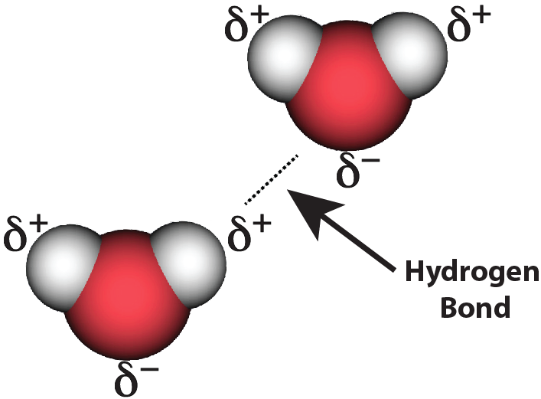
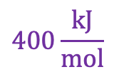
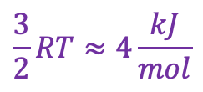
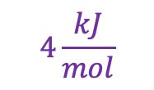
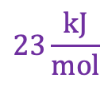
… And of the importance of the fact that $\frac{3}{2}RT=4\frac{kJ}{mol}$ (at room T)
Covalent bonds after a collision …
vdw bonds after a collision …
$$400\frac{kJ}{mol}$$
C
C
$$23\frac{kJ}{mol}$$
$$4\frac{kJ}{mol}$$
$$\frac{3}{2}RT≈4\frac{kJ}{mol}$$
N
N
N
N

Slide 11
… And of the importance of the fact that $\frac{3}{2}RT=4\frac{kJ}{mol}$ (at room T)
Covalent bonds after a collision …
… are still intact!
vdw bonds after a collision …
… are likely to be torn asunder
$$400\frac{kJ}{mol}$$
C
C
$$23\frac{kJ}{mol}$$
$$4\frac{kJ}{mol}$$
$$\frac{3}{2}RT≈4\frac{kJ}{mol}$$
N
N
N
N

Slide 12
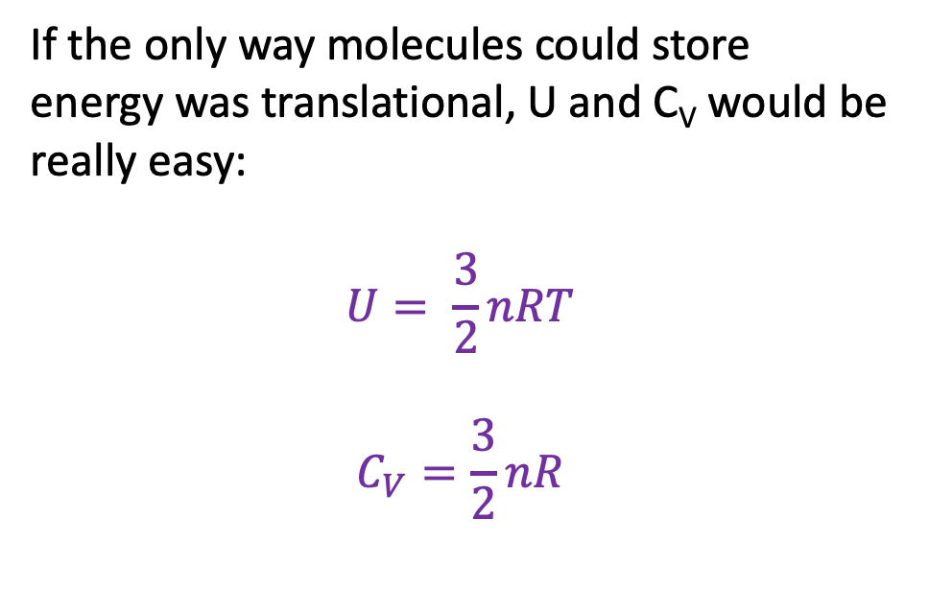
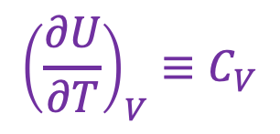
U as a thermodynamic surface
$${\left(\frac{∂U}{∂T}\right)}_{V}≡C_{V}$$
U(T,V)
If the only way molecules could store energy was translational, U and C_{V} would be really easy:
$$U= \frac{3}{2}nRT$$
$$C_{V}=\frac{3}{2}nR$$
V
“State Space”
T
Isochoric heating

Slide 13
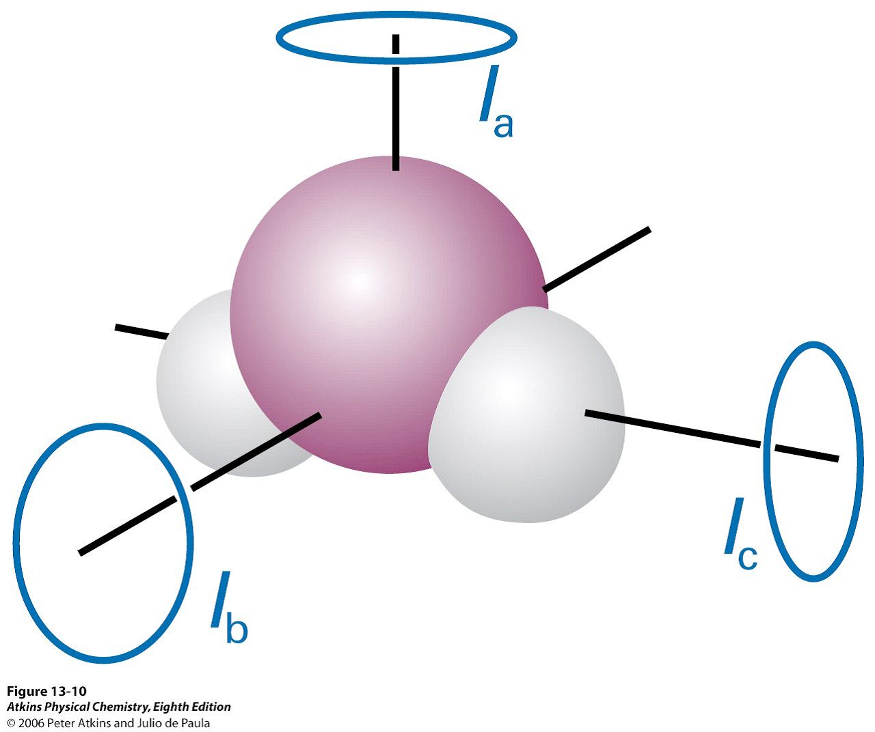
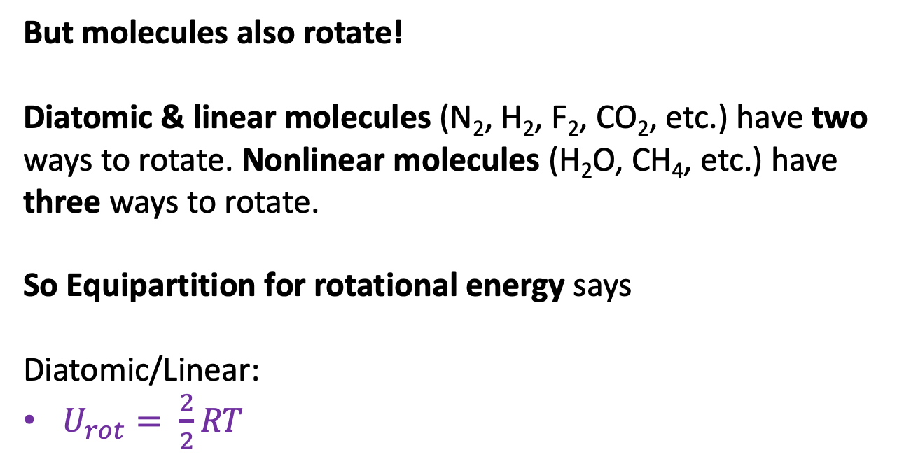
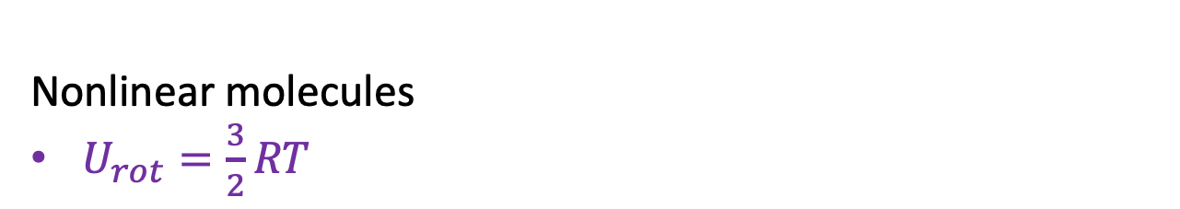
But molecules also rotate!
Diatomic & linear molecules (N₂, H₂, F₂, CO₂, etc.) have two ways to rotate. Nonlinear molecules (H₂O, CH₄, etc.) have three ways to rotate.
So Equipartition for rotational energy says
Diatomic/Linear:
$U_{rot}= \frac{2}{2}RT$
N
Rotating in-plane and out-of-plane
N
Nonlinear molecules
$U_{rot}=\frac{3}{2}RT$
Rotating in three distinct directions

Slide 14
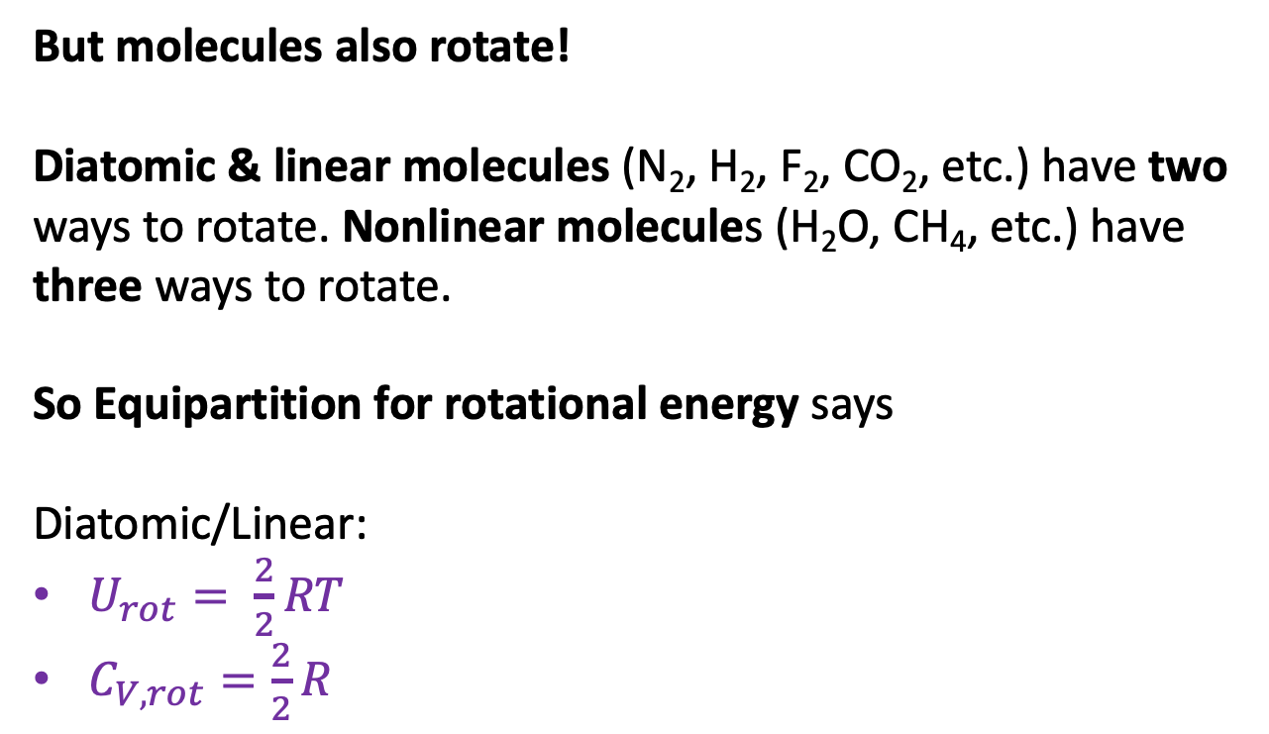

But molecules also rotate!
Diatomic & linear molecules (N₂, H₂, F₂, CO₂, etc.) have two ways to rotate. Nonlinear molecules (H₂O, CH₄, etc.) have three ways to rotate.
So Equipartition for rotational energy says
Diatomic/Linear:
$U_{rot}= \frac{2}{2}RT$
$C_{V,rot}=\frac{2}{2}R$
N
Rotating in-plane and out-of-plane
N
Nonlinear molecules
$U_{rot}=\frac{3}{2}RT$
Rotating in three distinct directions

Slide 15
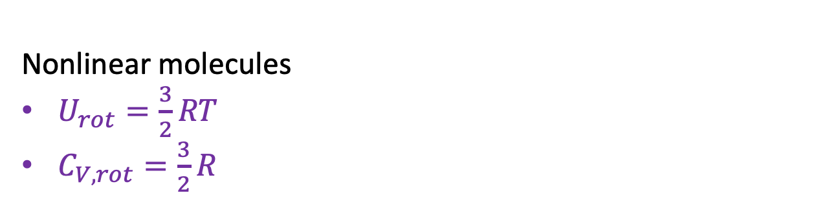
But molecules also rotate!
Diatomic & linear molecules (N₂, H₂, F₂, CO₂, etc.) have two ways to rotate. Nonlinear molecules (H₂O, CH₄, etc.) have three ways to rotate.
So Equipartition for rotational energy says
Diatomic/Linear:
$U_{rot}= \frac{2}{2}RT$
$C_{V,rot}=\frac{2}{2}R$
N
Rotating in-plane and out-of-plane
N
Nonlinear molecules
$U_{rot}=\frac{3}{2}RT$
$C_{V,rot}=\frac{3}{2}R$
Rotating in three distinct directions

Slide 16
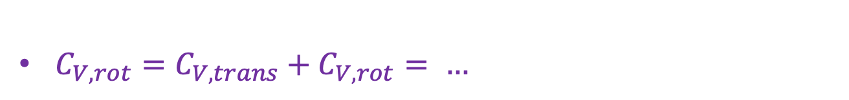

Energy of rotations combined with translations
Diatomic/linear:
N
Rotating in-plane and out-of-plane
N
$U=U_{trans}+U_{rot}= …$
$C_{V,rot}=C_{V,trans}+C_{V,rot}= …$
Rotating in three distinct directions

Slide 17

Energy of rotations combined with translations
Diatomic/linear:
N
Rotating in-plane and out-of-plane
N
$U=U_{trans}+U_{rot}=\frac{5}{2}RT$
$C_{V,rot}=C_{V,trans}+C_{V,rot}= …$
Rotating in three distinct directions

Slide 18
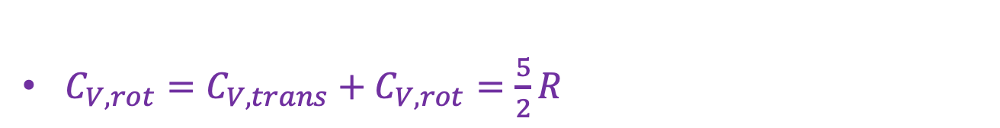
Energy of rotations combined with translations
Diatomic/linear:
N
Rotating in-plane and out-of-plane
N
$U=U_{trans}+U_{rot}=\frac{5}{2}RT$
$C_{V,rot}=C_{V,trans}+C_{V,rot}=\frac{5}{2}R$
Rotating in three distinct directions

Slide 19
Energy of rotations combined with translations
Nonlinear molecules:
N
Rotating in-plane and out-of-plane
N
$U=U_{trans}+U_{rot}= …$
$C_{V,rot}=C_{V,trans}+C_{V,rot}= …$
Rotating in three distinct directions

Slide 20

Energy of rotations combined with translations
Nonlinear molecules:
N
Rotating in-plane and out-of-plane
N
$U=U_{trans}+U_{rot}=\frac{6}{2}RT$
$C_{V,rot}=C_{V,trans}+C_{V,rot}= …$
Rotating in three distinct directions

Slide 21

Energy of rotations combined with translations
Nonlinear molecules:
N
Rotating in-plane and out-of-plane
N
$U=U_{trans}+U_{rot}=\frac{6}{2}RT$
$C_{V,rot}=C_{V,trans}+C_{V,rot}=\frac{6}{2}R$
Rotating in three distinct directions

Slide 22
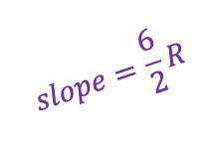

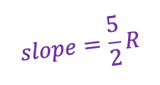



Bigger molecules => steeper increase in U as temperature increases & bigger heat capacities
$$slope=\frac{6}{2}R$$
$U=\frac{6}{2}RT$ (nonlinear molecules)
U
$$slope=\frac{5}{2}R$$
$U=\frac{5}{2}RT$ (diatomic/linear molecules)
$$\frac{6}{2}R$$
C_{V}
$$\frac{5}{2}R$$
T

Slide 23
Bigger molecules => steeper increase in U as temperature increases & bigger heat capacities
$$slope=\frac{6}{2}R$$
$U=\frac{6}{2}RT$ (nonlinear molecules)
U
$$slope=\frac{5}{2}R$$
$U=\frac{5}{2}RT$ (diatomic/linear molecules)
Don’t get too attached to this picture because the slope can change even for a given molecule!
$$\frac{6}{2}R$$
C_{V}
$$\frac{5}{2}R$$
T

Slide 24






Bigger molecules => steeper increase in U as temperature increases & bigger heat capacities
$$slope=\frac{6}{2}R$$
$U=\frac{6}{2}RT$ (nonlinear molecules)
U
$$slope=\frac{5}{2}R$$
$U=\frac{5}{2}RT$ (diatomic/linear molecules)
Don’t get too attached to this picture because the slope can change even for a given molecule!
$$\frac{6}{2}R$$
C_{V}
$$\frac{5}{2}R$$
T

Slide 25

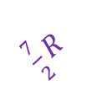
Nonlinear changes in U(T) and C_{V}(T) => activating vibrational motion!
$$slope=\frac{6}{2}R$$
U
$\frac{7}{2}R$
U gets steeper – and the heat capacity increases – because the molecule has crossed a vibrational threshold, T*.
When T<T*, molecules are not vibrating.
When T<T*, molecules are vibrating.
$$slope=\frac{5}{2}R$$
Not vibrating
vibrating
$\frac{7}{2}R$
$$\frac{6}{2}R$$
C_{V}
$$\frac{5}{2}R$$
T
T*

Slide 26
The classical limit
$$slope=\frac{6}{2}R$$
U
$\frac{7}{2}R$
This transition is actually a quantum effect that only occurs at low temperature. For that reason, the high-temperature limit of C_{V} is also called the classical limit.
$$slope=\frac{5}{2}R$$
Not vibrating
vibrating
$\frac{7}{2}R$
$$\frac{6}{2}R$$
C_{V}
$$\frac{5}{2}R$$
T
T*
High-temperature (classical) limit

Slide 27
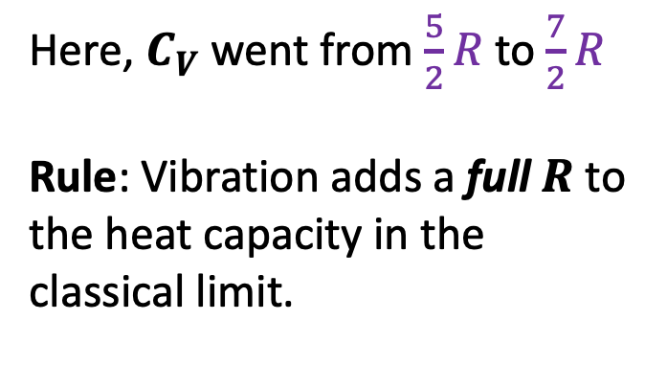
Rule for heat capacities in the classical limit
$$slope=\frac{6}{2}R$$
U
$\frac{7}{2}R$
$$slope=\frac{5}{2}R$$
Here, $C_{V}$went from $\frac{5}{2}R$to $\frac{7}{2}R$
Rule: Vibration adds a full $R$ to the heat capacity in the classical limit.
Not vibrating
vibrating
$\frac{7}{2}R$
$$\frac{6}{2}R$$
C_{V}
$$\frac{5}{2}R$$
T
T*
High-temperature (classical) limit

Slide 28
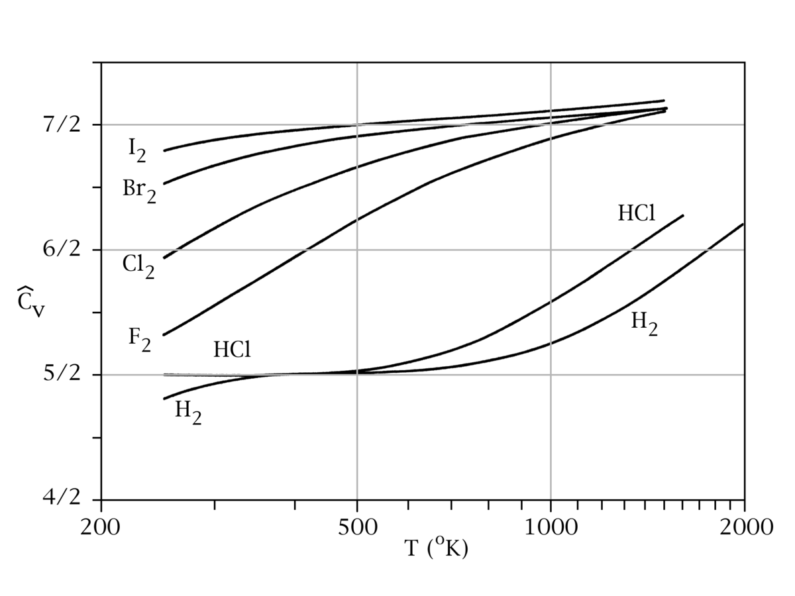
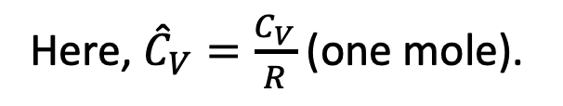
What heat capacities look like in real life
Here, ${\hat{C}}_{V}=\frac{C_{V}}{R}$ (one mole).
Anything strike you about these data?

Slide 29
What heat capacities look like in real life
Here, ${\hat{C}}_{V}=\frac{C_{V}}{R}$ (one mole).
Focus on HCl first

Slide 30
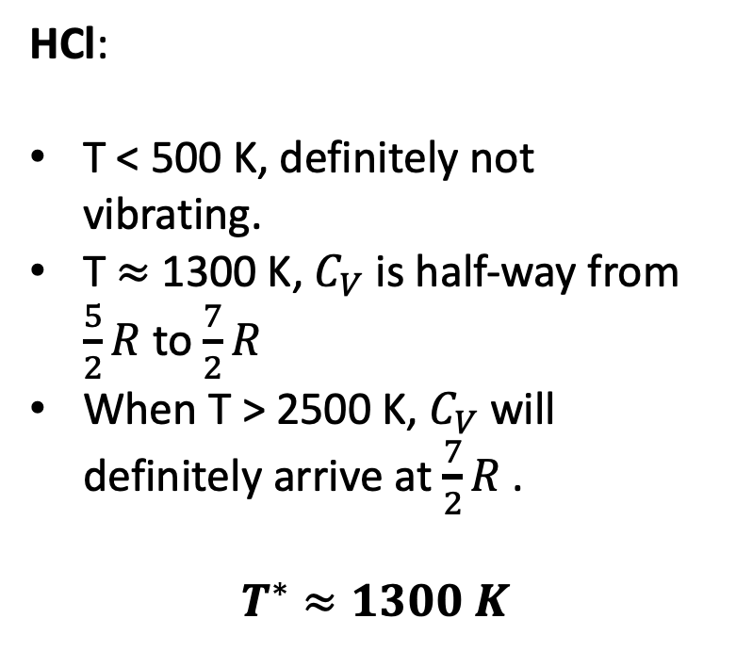
What heat capacities look like in real life
Here, ${\hat{C}}_{V}=\frac{C_{V}}{R}$ (one mole).
HCl:
T < 500 K, definitely not vibrating.
T $≈$ 1300 K, $C_{V}$is half-way from $\frac{5}{2}R$ to $\frac{7}{2}R$
When T > 2500 K, $C_{V}$will definitely arrive at $\frac{7}{2}R$ .
$$T^{∗}≈1300 K$$

Slide 31
What heat capacities look like in real life
Here, ${\hat{C}}_{V}=\frac{C_{V}}{R}$ (one mole).
What do you make of F₂?

Slide 32
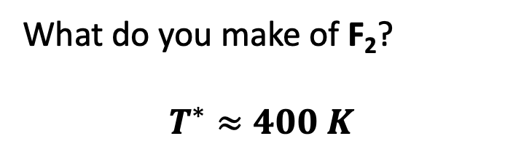
What heat capacities look like in real life
Here, ${\hat{C}}_{V}=\frac{C_{V}}{R}$ (one mole).
What do you make of F₂?
$$T^{∗}≈400 K$$

Slide 33
What heat capacities look like in real life
Here, ${\hat{C}}_{V}=\frac{C_{V}}{R}$ (one mole).
What do you make of H₂?

Slide 34
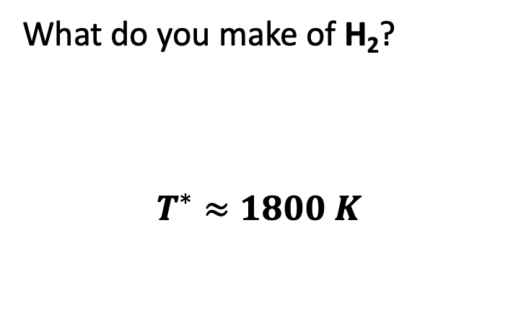
What heat capacities look like in real life
Here, ${\hat{C}}_{V}=\frac{C_{V}}{R}$ (one mole).
What do you make of H₂?
$$T^{∗}≈1800 K$$

Slide 35
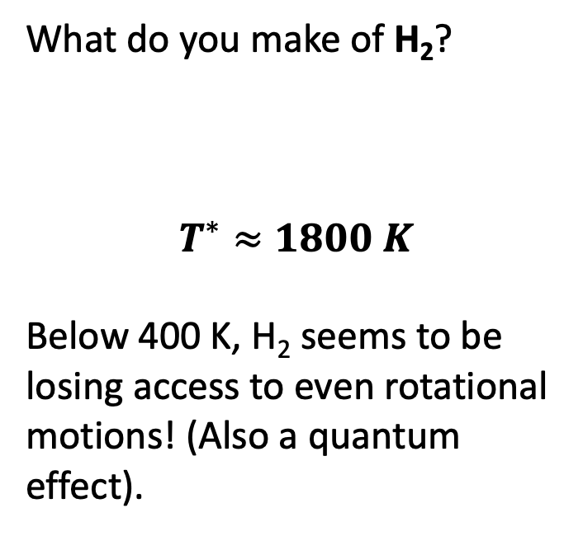
What heat capacities look like in real life
Here, ${\hat{C}}_{V}=\frac{C_{V}}{R}$ (one mole).
What do you make of H₂?
$$T^{∗}≈1800 K$$
Below 400 K, H₂ seems to be losing access to even rotational motions! (Also a quantum effect).

Slide 36
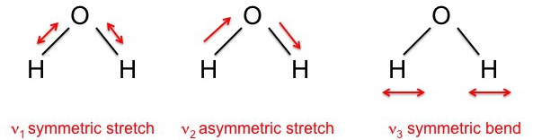
Polyatomic molecules actually have multiple vibrational modes
Example: H₂O has three vibrational modes
Molecules with more atoms have even more vibrational modes
At high temperature, all become active (each with their own characteristic $T^{∗}$)

Slide 37
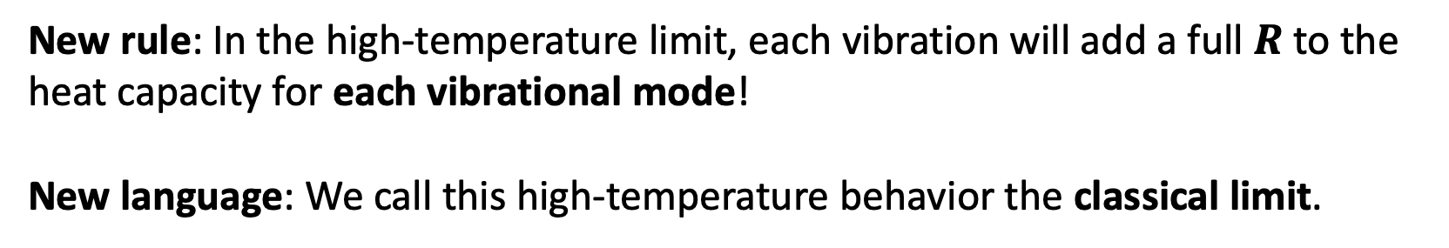
Polyatomic molecules actually have multiple vibrational modes
Example: H₂O has three vibrational modes
Molecules with more atoms have even more vibrational modes
At high temperature, all become active (each with their own characteristic $T^{∗}$)
New rule: In the high-temperature limit, each vibration will add a full $R$ to the heat capacity for each vibrational mode!
New language: We call this high-temperature behavior the classical limit.

Slide 38
Let’s do a full analysis of water …
Write down C_{V} in the low-temperature limit
Write down C_{V} in the high-temperature limit
Putting T* at about the middle of your x-axis, sketch U(T) and C_{V} (T)

Slide 39
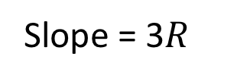
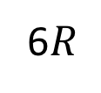
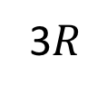
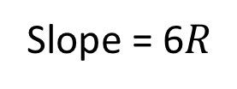
Let’s do a full analysis of water …
Write down C_{V} in the low-temperature limit
Write down C_{V} in the high-temperature limit
Putting T* at about the middle of your x-axis, sketch U(T) and C_{V} (T)
Slope = 6$R$
U(T)
Slope = 3$R$
C_{V}(T)
6$R$
3$R$
T*
T

Slide 40
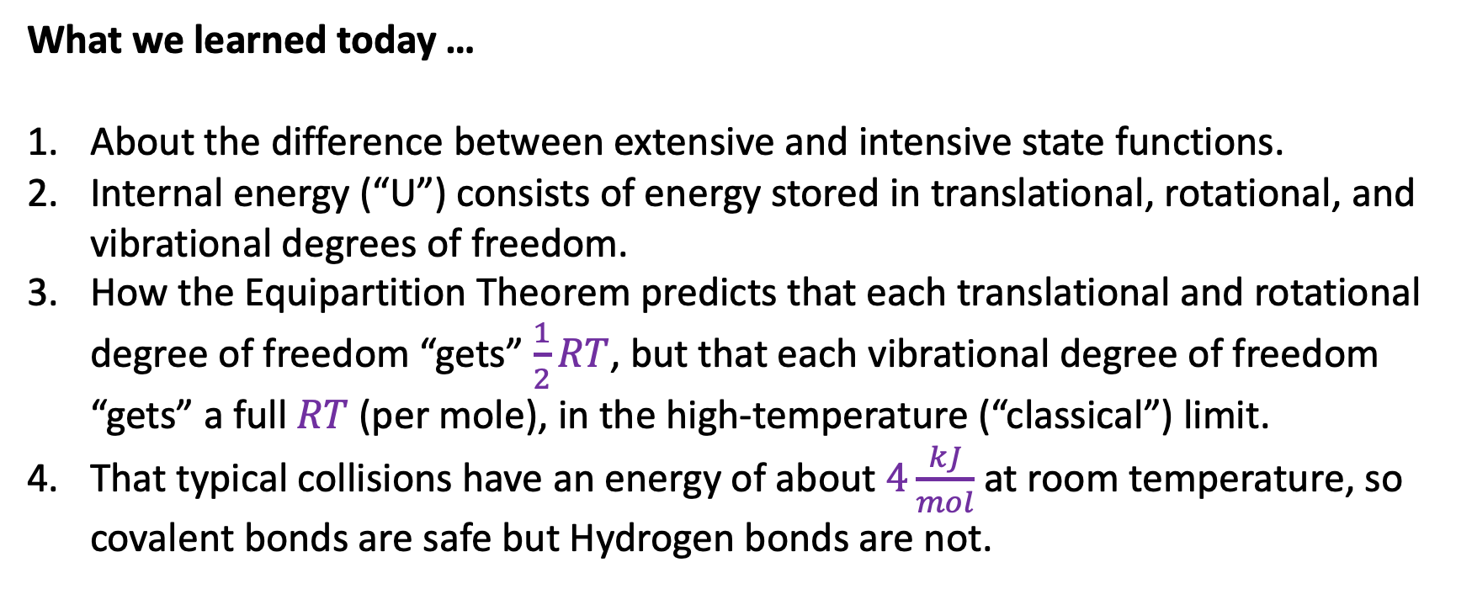
What we learned today …
About the difference between extensive and intensive state functions.
Internal energy (“U”) consists of energy stored in translational, rotational, and vibrational degrees of freedom.
How the Equipartition Theorem predicts that each translational and rotational degree of freedom “gets” $\frac{1}{2}RT$, but that each vibrational degree of freedom “gets” a full $RT$ (per mole), in the high-temperature (“classical”) limit.
That typical collisions have an energy of about $4\frac{kJ}{mol}$ at room temperature, so covalent bonds are safe but Hydrogen bonds are not.

